Slide 1
Regular Meeting
August 25, 2025

Slide 2
Goal & Purpose of LEAAC
Advise/Recommend/Engage
We will work on ways to engage the neighbors who live and work in the surrounding communities to:
Communication/Coordination
We will monitor what is happening at and around the airport and advise the MAC on how to best respond
Education/Orientation
We will educate the LEAAC, MAC staff, and public attendees on airport operations, the users and the surrounding committees
Show the value of the airport to the community
Maximize the positive educational, recreational, and economic aspects
Use the airport and airport events to create community with the airport users and neighbors
Noise and operations
Development
Other community interests
Airport operations
Who uses this specific airport
Who lives around this specific airport
The various roles of operating and regulating organizations (e.g., MAC, FAA, USDA, MNDOT, etc.)”

Slide 3
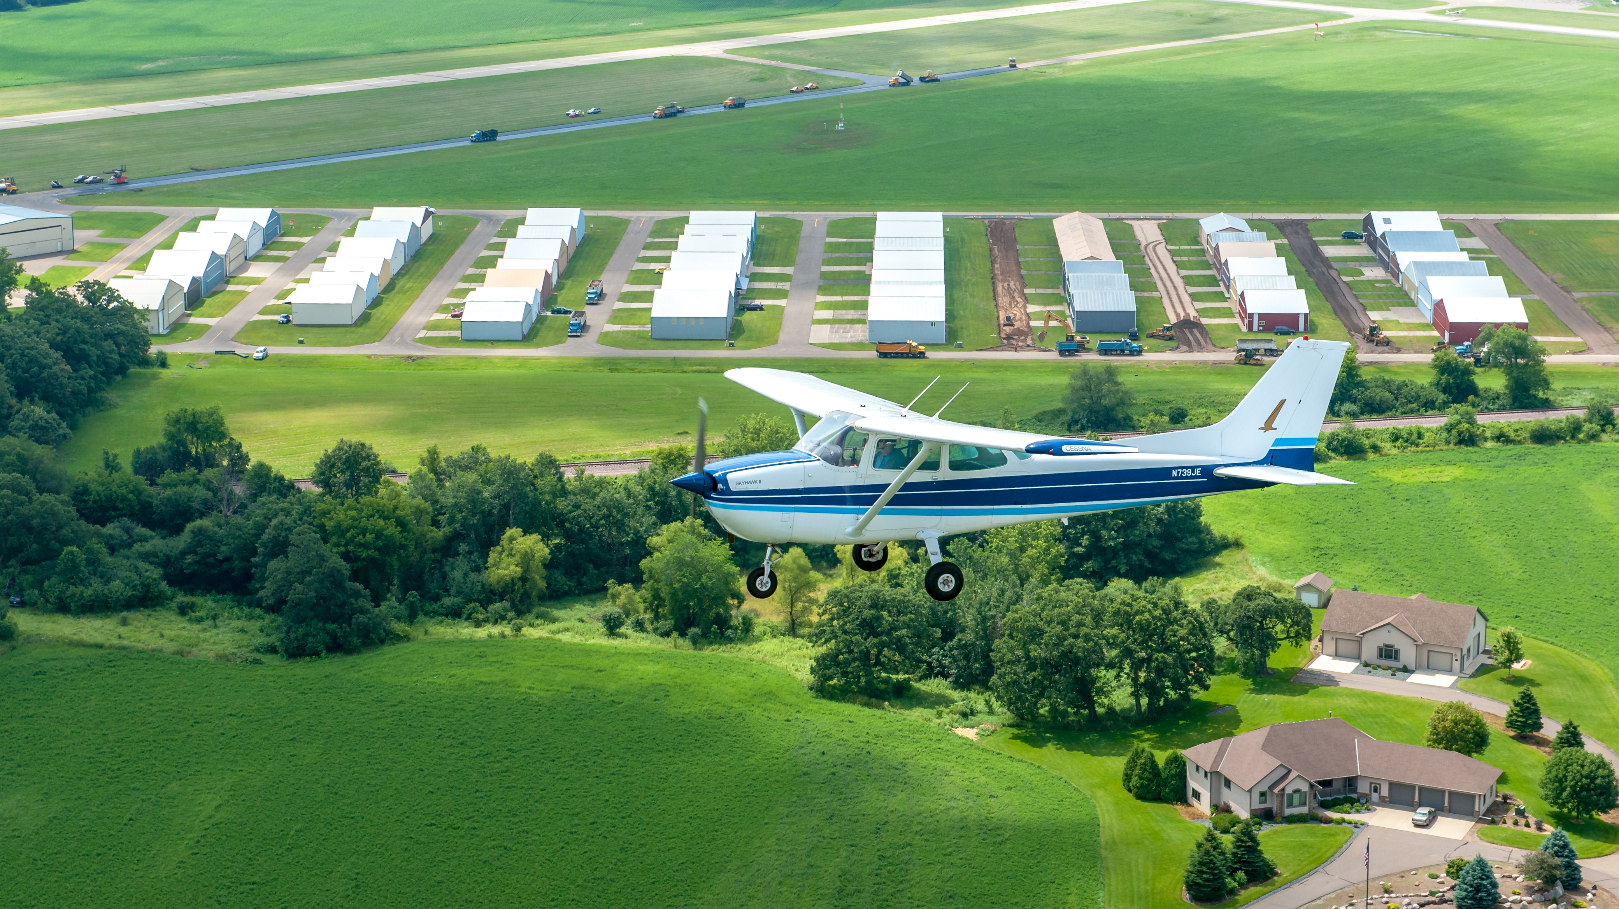
Welcome & Introductions
Consent Items
Public Comment
Business
Comparative Review of Fly Neighborly Program Strategies
Information
Community Spotlight
MAC Update
Member Comment
Review Meeting Schedule
Agenda

Slide 4

Welcome & Introductions
Notes:
Introduce Paul Evenson, replacing Marlon Gunderson

Slide 5
Consent

Slide 6
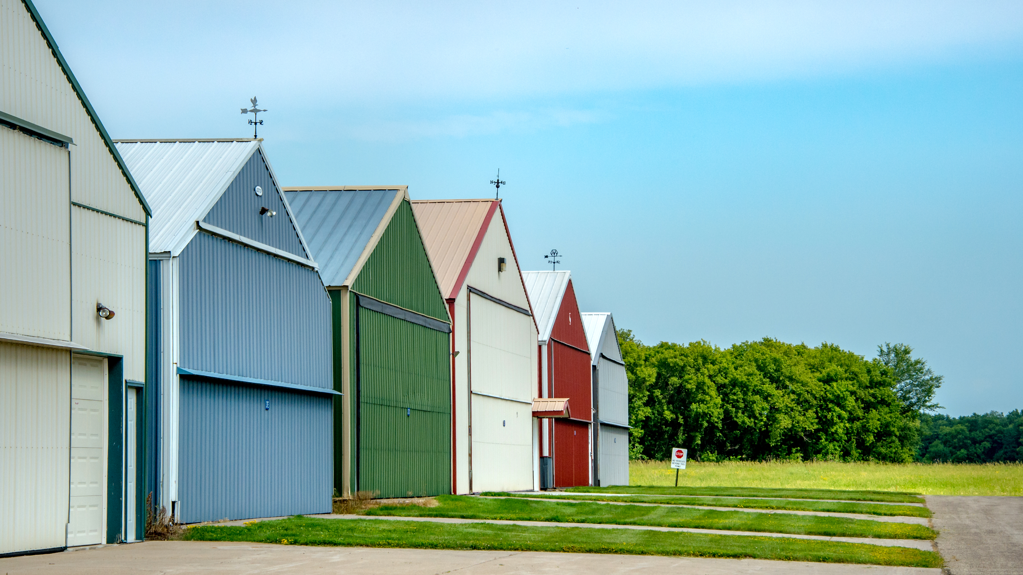
Public Comment
Members of the public are welcome to share their remarks with the Commission.
Please state your name and address for the record
Limit remarks to 3 minutes

Slide 7
Business

Slide 8
Comparative Review of Fly Neighborly Program Strategies

Slide 9
Information
Notes:
Michele

Slide 10
Community Spotlight
Notes:
Luke

Slide 11
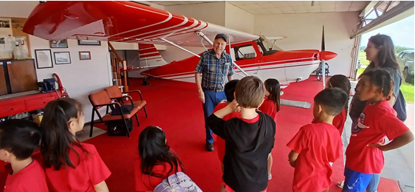
21D User Profiles
Al Kupferschmidt
Al is a long-time resident of West
Lakeland Township and has been a
fixture at 21D for over 5 decades. Al
used the GI Bill to train at Lake Elmo
and received his pilot’s license in
1974. Shortly after he started flying
Al found an aircraft like he trained on
and bought the Citabria aircraft which
he flies today, nearly 45 years later.
Al loves being in aviation. He lives by
the airport and uses the airport to pursue his passion. He also shares this passion with others. Having volunteered with EAA for years, he has given more than 600 kids introductory rides through the Young Eagles program.
In his mid-80’s Al and his son flies the Citabria regularly taking 100 or so flights a year.
Notes:
Jennifer

Slide 12
LEAAC Members Share Community Highlights and Connection to
Lake Elmo Airport
Notes:
Luke

Slide 13
MAC Update
Notes:
Phil

Slide 14
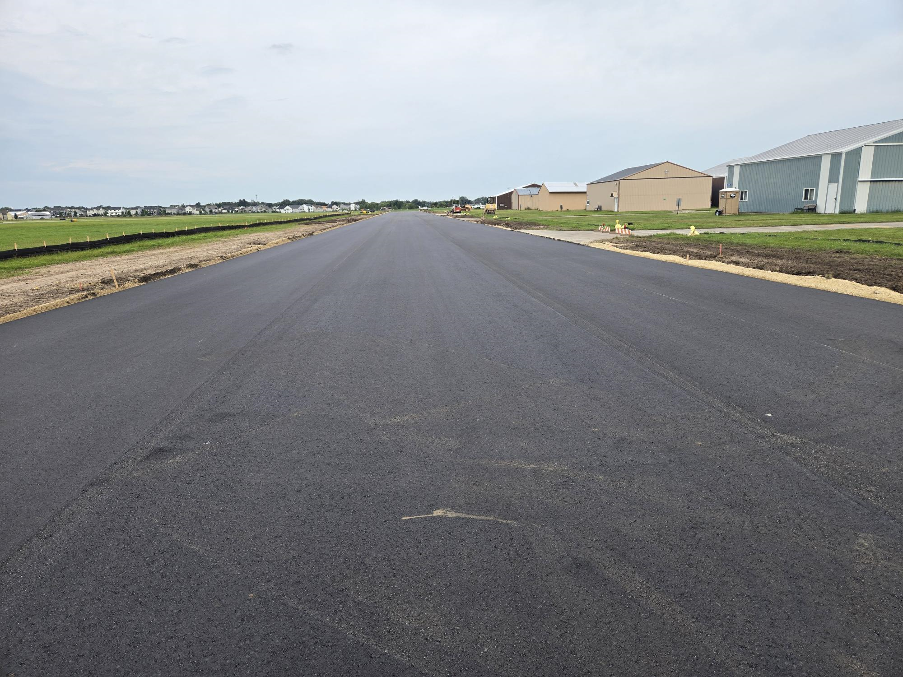
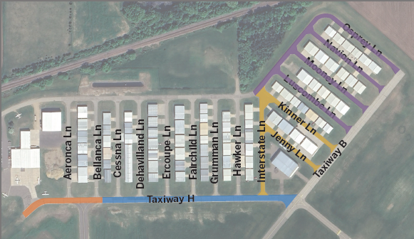
MAC Update
Taxiway H, Taxilanes, and Service Road Reconstruction
Equipment Building
Viewing Area Rebuild

Slide 15
MAC Update
Lake Elmo Aero Open House (8/2)
  Food Trucks
  Bouncy House and Kids Activities
  Aircraft Displays
  Women in Aviation Booth
  Classic Airplane Rides with the Commemorative Air
EAA Fly-In Breakfast (8/10)
  Local Fire, Police Departments, and a K9 Demonstration
  MAC Police
  MnDOT Aeronautics
  Aircraft Displays

Slide 16
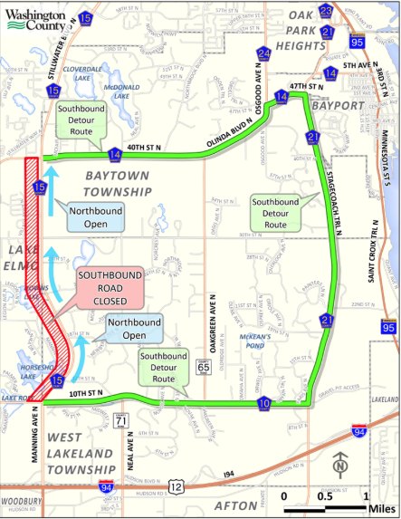
MAC Update
Washington County Fair (7/30 - 8/3)
  Located at the fair grounds just north of the airport
  Parade, exhibits, animal shows, carnival, music, helicopter rides, and more
County Highway 15 (Manning Ave) Pavement Improvements
  August 11 – Southbound lane closed
  Roadwork continues through the end of October

Slide 17
Member Comment

Slide 18
Review Meeting Schedule

Slide 19
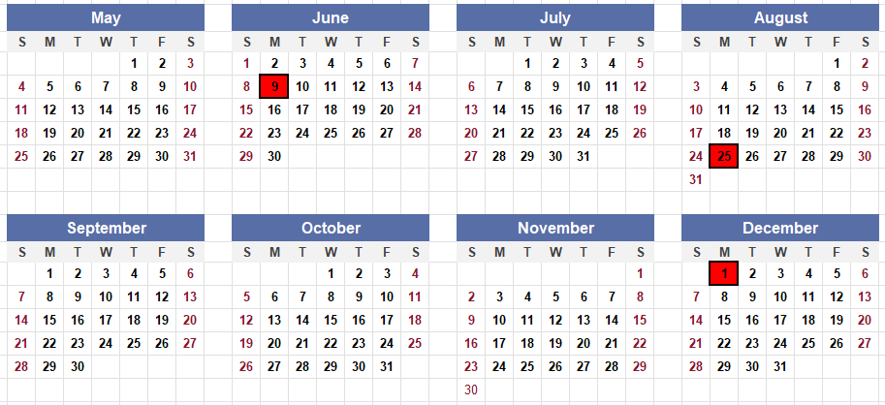
2025 LEAAC Meeting Dates:

Slide 20
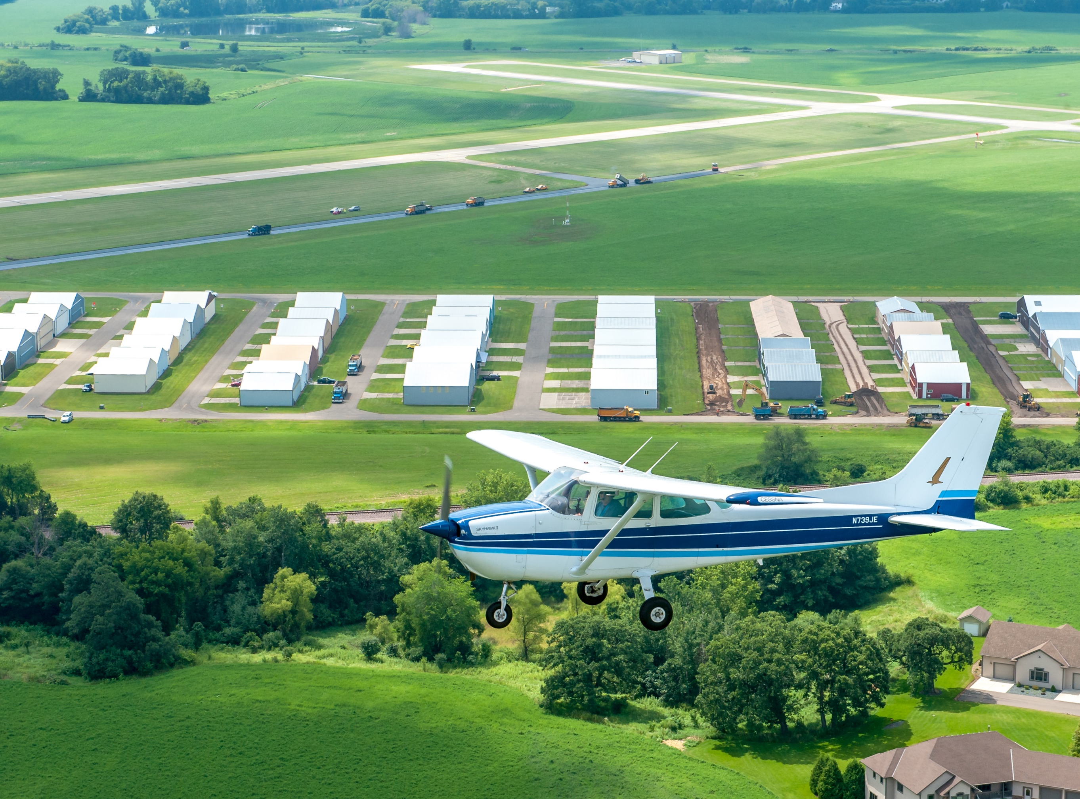
Thank you for joining us!

